Slide 1
Employee Data Analysis using Excel
STUDENT NAME: SIVARANJANI.V
REGISTER NO:122203103&(unm14512022h44)
DEPARTMENT: B COM (CS)
COLLEGE: MAHALASHMI WOMEN'S COLLEGE OF ARTS AND SCIENCE

Slide 2
PROJECT TITLE
Employee Performance Analysis using Excel

Slide 3


AGENDA
Problem Statement
Project Overview
End Users
Our Solution and Proposition
Dataset Description
Modelling Approach
Results and Discussion
Conclusion
3/21/2024 Annual Review

Slide 4

PROBLEM STATEMENT
Please provide the problem statement, and I'll do my best to assist you. Keep in mind that I can help with a wide range of topics, including but not limited to:
- Writing and proofreading
- Research and data analysis
- Math and calculations
- Conversation and brainstorming
Go ahead and share the problem!

Slide 5

PROJECT OVERVIEW
Please provide the project details, and I'll summarize it in 50 words or less. If you'd like, I can also help with:
- Project planning and organization
- Goal setting and objectives
- Identifying key stakeholders and resources
- Developing a project timeline and milestones
Share your project information!
.

Slide 6

WHO ARE THE END USERS?
1.IT COMPANY
2.BANK
3.HRM
4.INDUSTRIES
5.MARKETING FIELD

Slide 7

OUR SOLUTION AND ITS VALUE PROPOSITION
1.Conditional formatting
2. Formula
3.Filtering
4.pivot table
5.Bar chart / pie chart

Slide 8
Dataset Description
1. Employee data downloaded from edunet dashboard.
2. Featured:
Totally 26 features were available in that 11 were considered
3. General code.
4. First name.
5. Business unit.
6. Performance level.

Slide 9

THE "WOW" IN OUR SOLUTION
=IFS(K2>=5,"very high",K2>=4,"high",K2>=3,"medium",true,"low")
3/21/2024 Annual Review
9

Slide 10
MODELLING
1. SUMMERISING:
Pivot table is created to summerise
2. Filter - Gender code
3. Column- performance level
4. Rows - Business unit
5.values- count of first name
6. Visualisation:
Bar graph
Pie chart
10

Slide 11
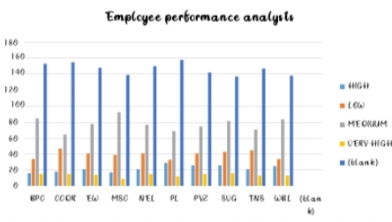
RESULTS
11

Slide 12
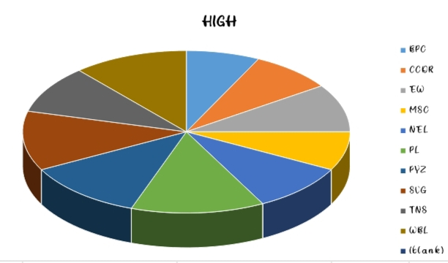
RESULTS

Slide 13
conclusion
Employee Data Analysis using Excel
Therefore the SVG business unit employees performs higher comparing to other units and whereas PL business unit performs lower comparing to other units. Hence the SVG business unit employees works more efficiently and effectively comparing to other units according to the employee data given.

